Slide 1

Fundamental Of Structured Programming Lecture 6
Dr. Ahmed Yousry
Lecturer, Computer Science Department,
Faculty of computers and artificial intelligence, benha university

Slide 2


Slide 3
Flag
A variable used to signal the presence or absence of a particular condition in a program
Usually implemented as a bool
Meaning:
true: the condition exists
false: the condition does not exist
Flags are often used to control the flow of a program
The flag value can be both set and tested with if statements.

Slide 4
Flag Example
Example:
bool validMonths = true;
…
if (months < 0)
validMonths = false;
…
if (validMonths)
moPayment = total / months;

Slide 5
Integer Flags
Integer variables can be used as flags.
Remember that 0 means false, any other value means true.
Example:
int allDone = 0; // set to false
…
if (count > MAX_STUDENTS)
allDone = 1; // set to true
…
if (allDone)
cout << "Task finished";

Slide 6
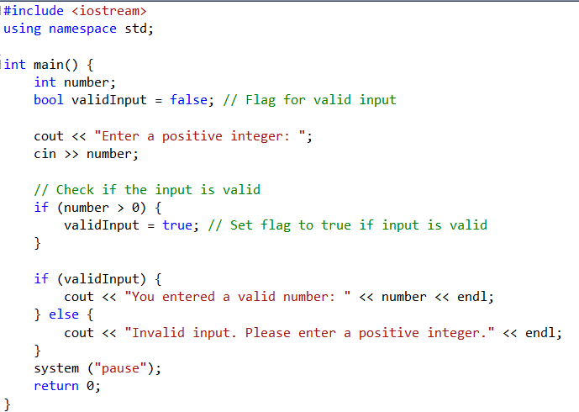

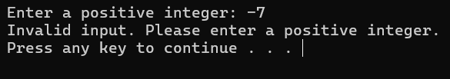
Examples
This example uses a flag to determine if a user has entered a valid number.

Slide 7
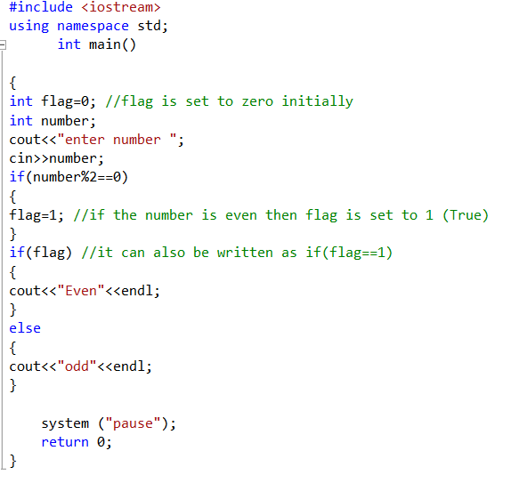
Example
This example uses a flag to check if the number is even or odd.

Slide 8

Validation Test

Slide 9
Checking Numeric Ranges with Logical Operators
Used to test to see if a value falls inside a range:
if (grade >= 0 && grade <= 100)
cout << "Valid grade";
Can also test to see if value falls outside of range:
if (grade <= 0 || grade >= 100)
cout << "Invalid grade";
Cannot use mathematical notation:
if (0 <= grade <= 100) //doesn’t work!

Slide 10
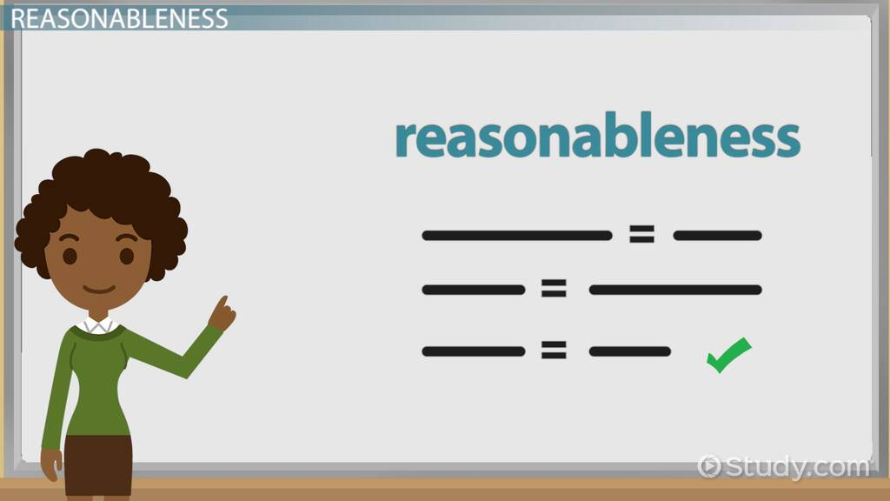
Validating User Input
Input validation: inspecting input data to determine if it is acceptable
Want to avoid accepting bad input
Can perform various tests
Range
Valid menu choice
Zero as a divisor
Notes:
Reasonableness اعتدال او معقولية

Slide 11
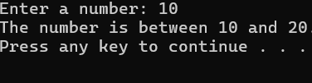
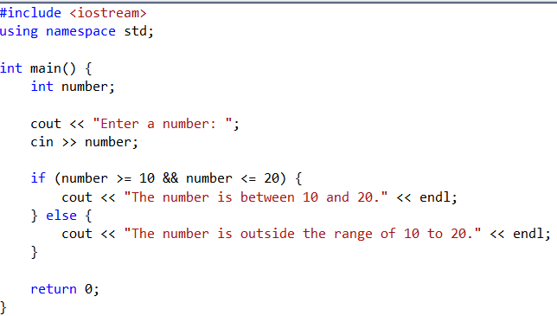

Example
This example checks if a number is between 10 and 20

Slide 12
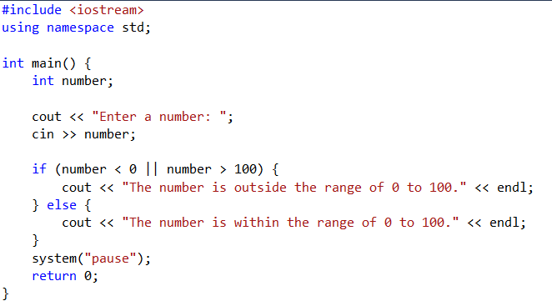


Example
This example checks if a number is either less than 0 or greater than 100

Slide 13
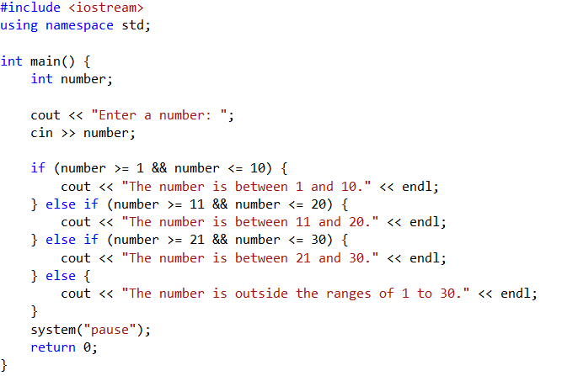




Example
This example checks if a number falls within different specified ranges and outputs the corresponding message.

Slide 14
The Conditional Operator

Slide 15
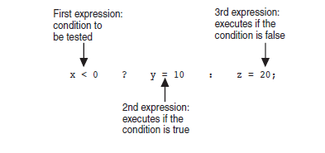
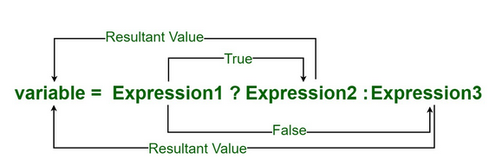
The Conditional Operator
The conditional operator is also known as a ternary operator.
It is used to write conditional operations provided by C++
Can use to create short if/else statements
Format: expr ? expr : expr;
Notes:
See pr4-22.cpp

Slide 16
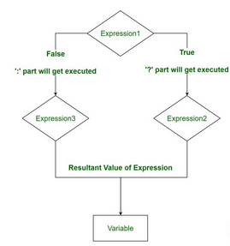
The Conditional Operator
Notes:
See pr4-22.cpp

Slide 17
The Conditional Operator
The value of a conditional expression is:
The value of the second expression if the first expression is true,
The value of the third expression if the first expression is false,
Parentheses () may be needed in an expression due to precedence of conditional operator.

Slide 18
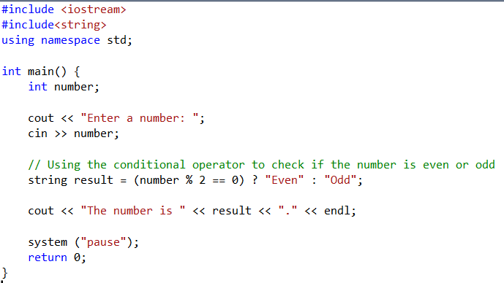


Example(check even or odd)

Slide 19
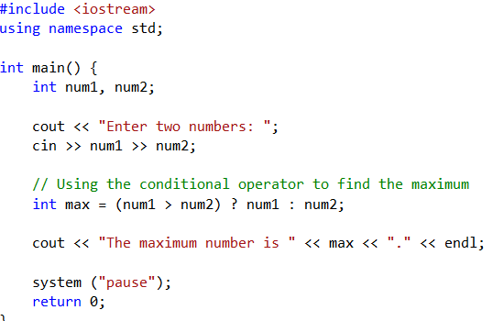
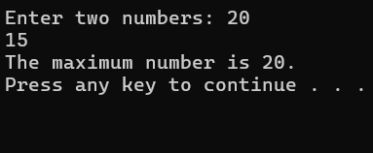
Example : Finding the Maximum of Two Numbers

Slide 20
switch Statement

Slide 21
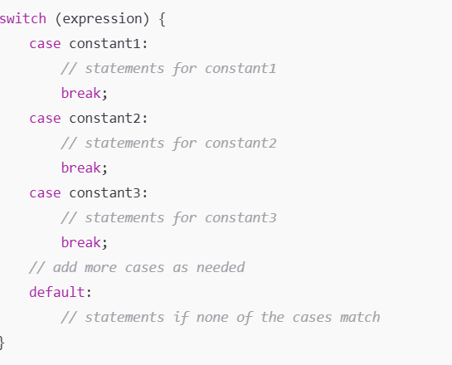
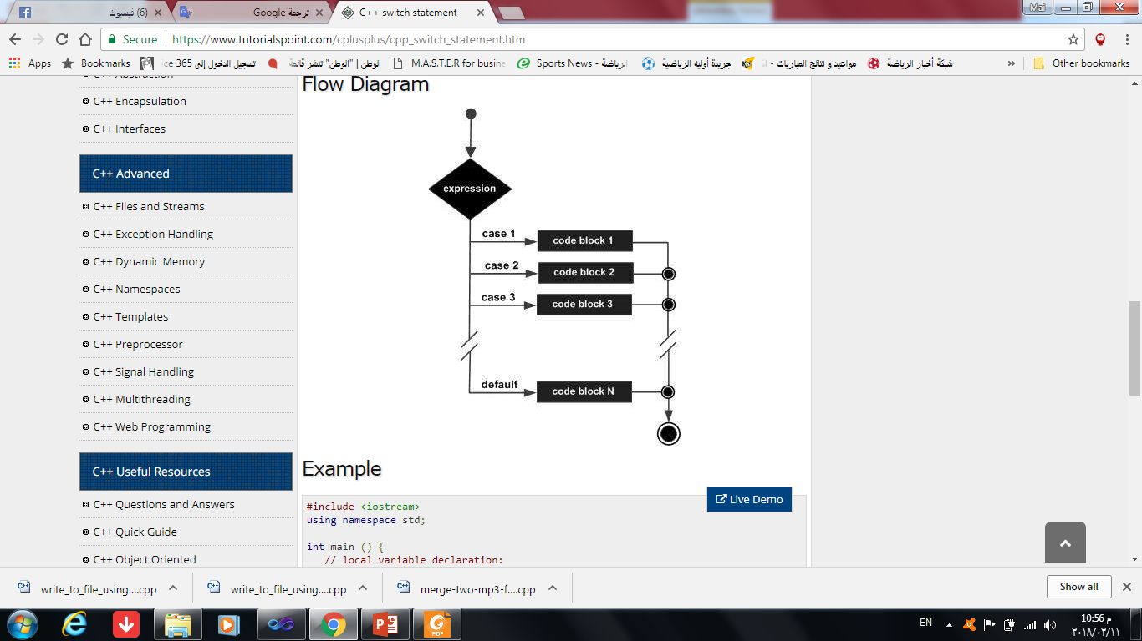
The switch Statement
Used to select among statements from several alternatives.
May sometimes be used instead of if/ else if statements.

Slide 22
switch Statement Requirement
Expression must be a char or an integer variable or an expression that evaluates to an integer value
exp1 through expn must be unique in the switch statement
default is optional but recommended

Slide 23
How the switch Statement Works
Expression is evaluated
The value of Expression is compared against exp1 through expn.
If Expression matches value expi, the program branches to the statement(s) following expi and continues to the end of the switch
If no matching value is found, the program branches to the statement after default:

Slide 24
Example switch Statement
switch (gender)
{
case 'f': cout << "female";
break;
case 'm': cout << "male";
break;
default :cout << "invalid gender";
}

Slide 25
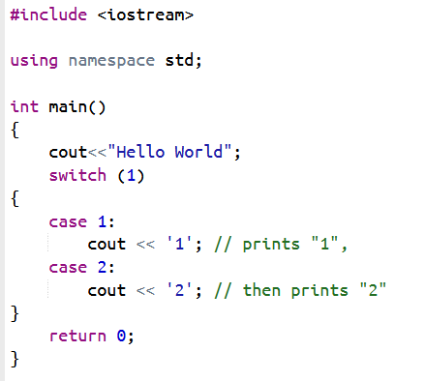

Example switch Statement

Slide 26
The break Statement
Used to stop execution in the current block
Also used to exit a switch statement
Useful to execute a single case statement without executing statements following it
Notes:
See pr4-23.cpp, pr4-24.cpp, pr4.25.cpp, and pr4-26.cpp

Slide 27
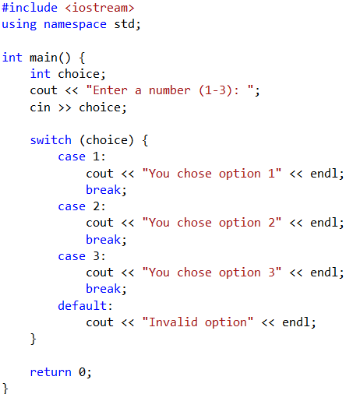
Example takes an integer input (1-3) and prints a corresponding message.
Program Runs:
Input: 2 → Output: "You selected option 2."
Input: 4 → Output: "Invalid selection!"
Input: 1 → Output: "You selected option 1."

Slide 28
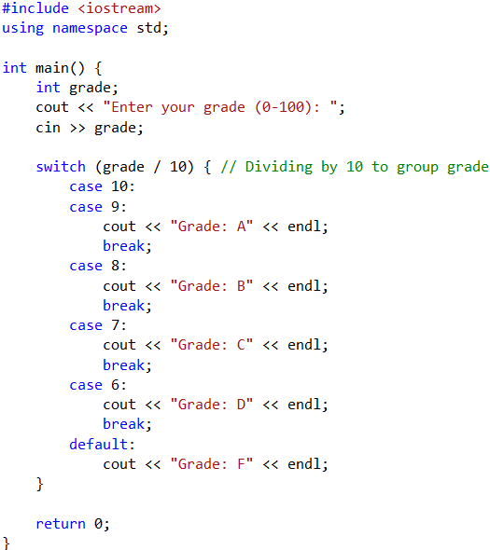
Example: assigns a letter grade based on a numeric grade
Program Runs:
Input: 95 → Output: Your letter grade is A.
Input: 82 → Output: Your letter grade is B.
Input: 67 → Output: Your letter grade is D.
Input: 50 → Output: Your letter grade is F.

Slide 29
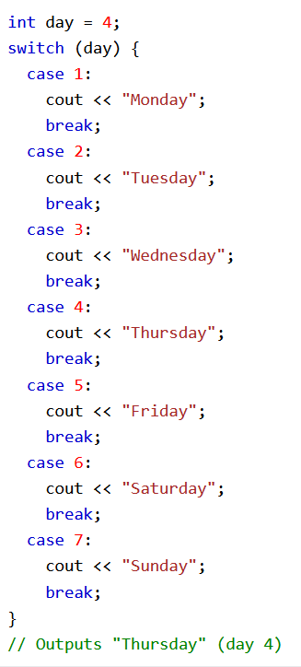
Example switch Statement

Slide 30
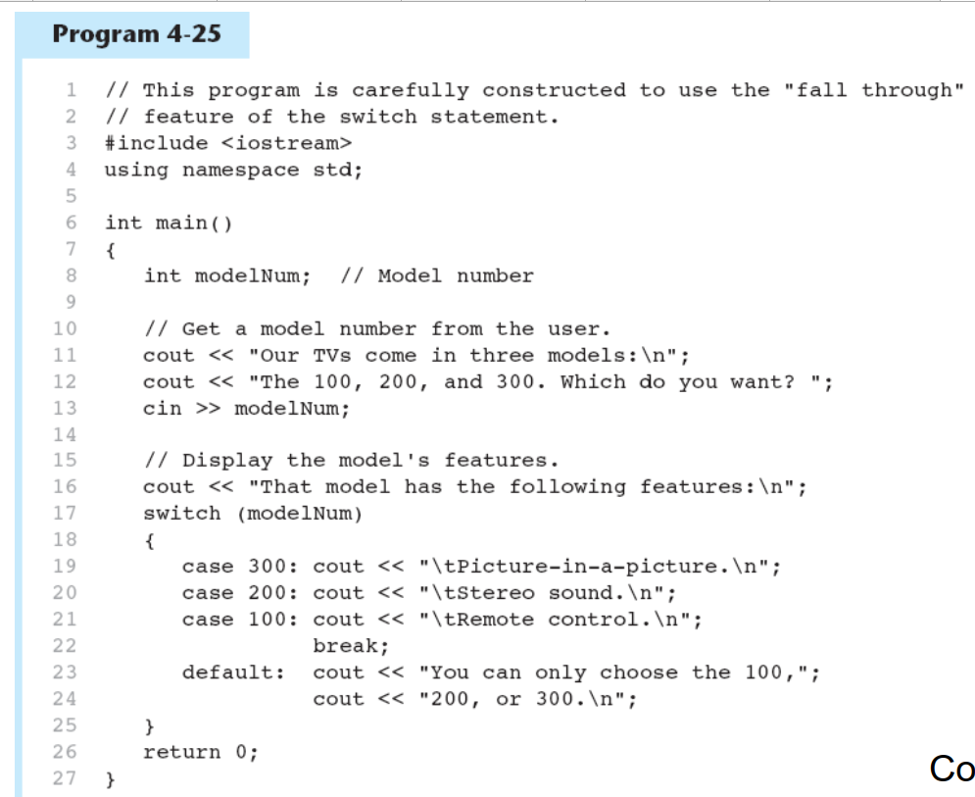
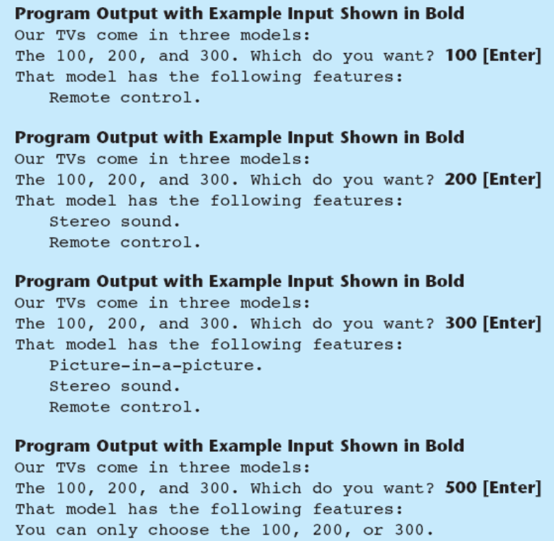
Example switch Statement

Slide 31
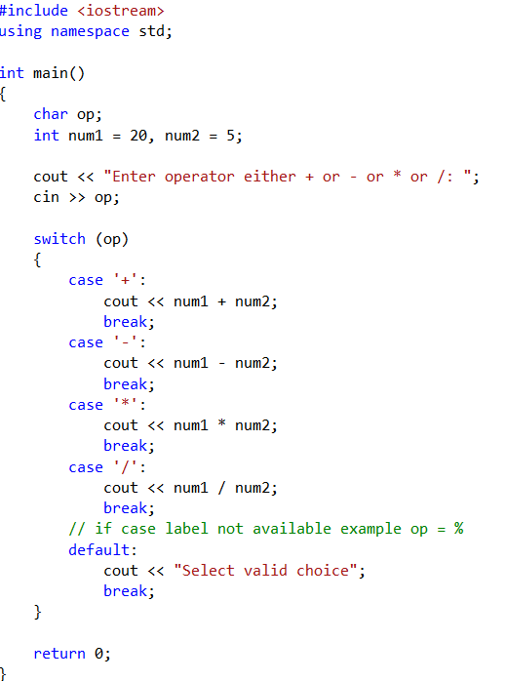




Example

Slide 32
Using switch with a Menu
A switch statement is a natural choice for menu-driven program
display menu
get user input
use user input as Expression in switch statement
use menu choices as exp to test against in the case statements
Notes:
See pr4-27.cpp

Slide 33
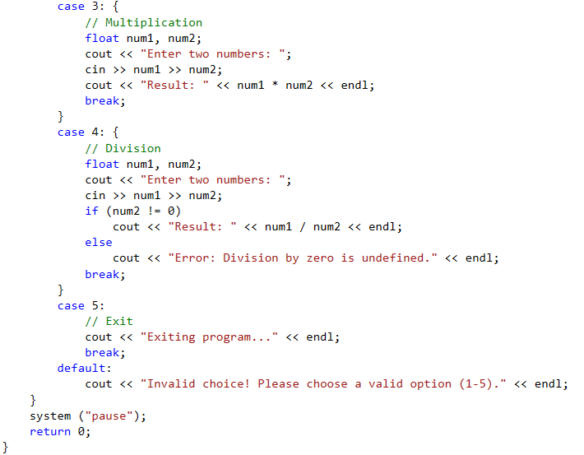
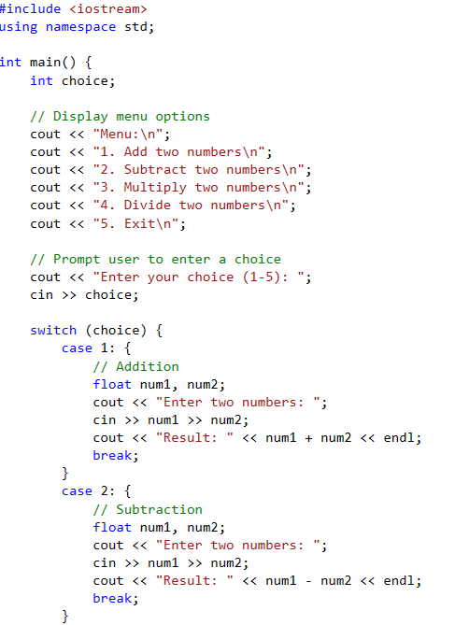
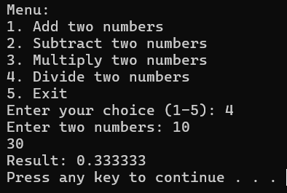
Example

Slide 34
More About Blocks and Scope

Slide 35
Variable Scope
Scope of a variable is the block in which it is defined, from the point of definition to the end of the block.
Usually defined at beginning of function.
May be defined close to first use.

Slide 36
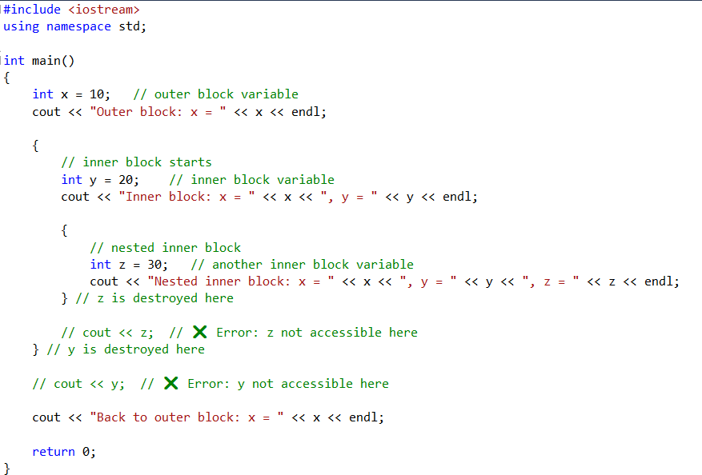
Variable Scope

Slide 37
Variables with the Same Name
Variables defined inside { } have local or block scope.
When inside a block within another block, can define variables with the same name as in the outer block.
When in inner block, outer definition is not available,
Not a good idea

Slide 38
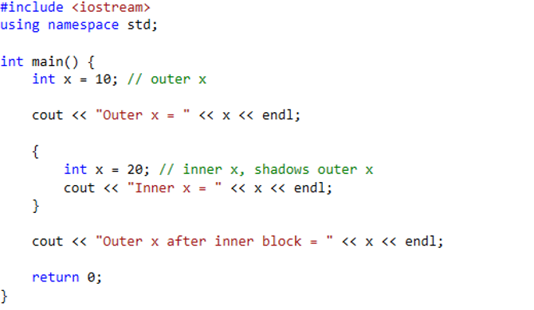
Example
Program Output:
Outer x = 10
Inner x = 20
Outer x after inner block = 10

Slide 39
Local &&global variables
A scope is a region of the program and broadly speaking.
There are three places, where variables can be declared:
Inside a function or a block {} which is called local variables,
In the definition of function parameters which is called formal parameters.
Outside of all functions which is called global variables.

Slide 40
Initializing Local and Global Variables
When a local variable is defined, it is not initialized by the system, must initialized by programmer.
Global variables are initialized automatically by the system as following:
Data Type | Initializer
int | 0
char | '\0'
float | 0
double | 0
pointer | NULL

Slide 41
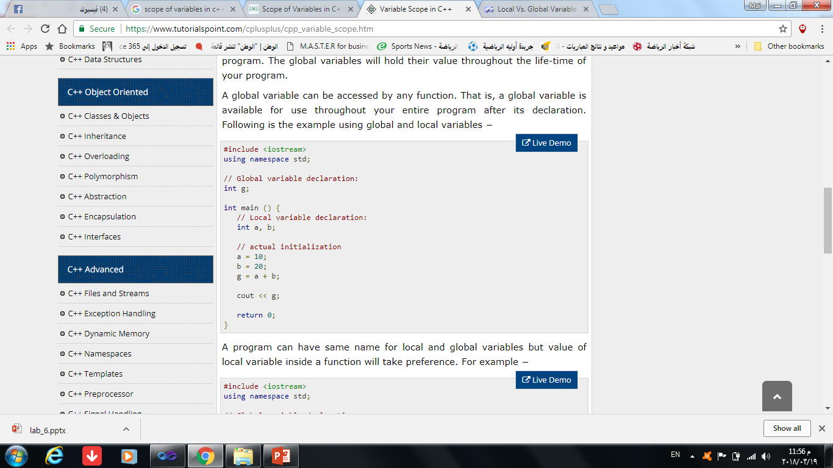
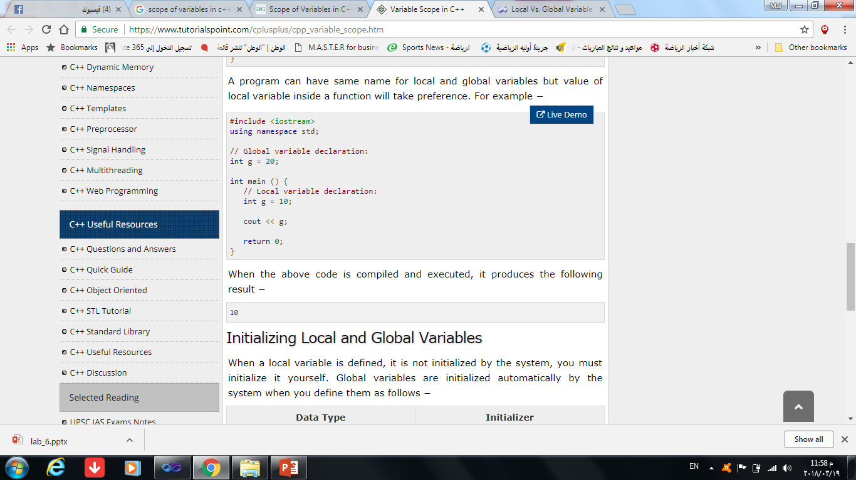
Local && Global Variables(cont.)

Slide 42
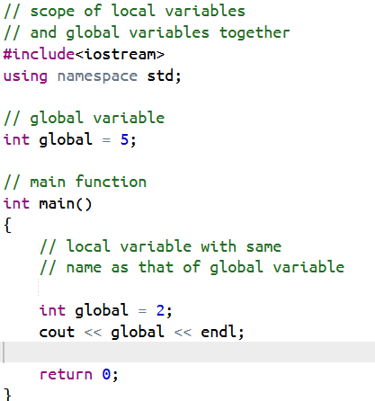
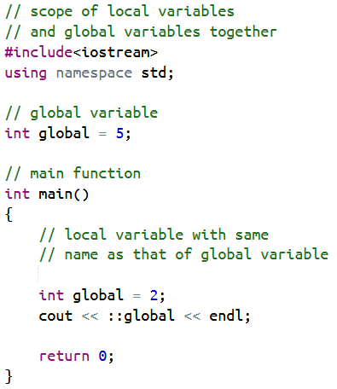
Example on Scope

Slide 43
Thank you

